Slide 1
Dynamic Arrays
Prof. Kaustubh Kulkarni

Slide 2
ArrayList
ArrayList is the implementation of List Interface.
The elements can be dynamically added or removed from the list.
Also, the size of the list is increased dynamically if the elements are added more than the initial size.
Though it may be slower than standard arrays, it can be helpful in programs where lots of manipulation in the array is needed.

Slide 3
Collection of pointers/references
An ArrayList is just an object, so we will create it like any other object – calling "new" and storing a pointer to the new ArrayList.
When first created, the ArrayList is empty – it does not contain any objects.
Traditionally, the things stored inside of a collection are called "elements" in the collection. (viz. elements of an array)
However in Java, collections always store pointers to objects, so we can also use the words "pointers" or "objects" to refer to the elements in a collection.

Slide 4
Creating and populating
This code creates a new, empty ArrayList:
ArrayList list = new ArrayList(); // make a new ArrayList (initially empty)
To add an object to the ArrayList, we call the add() method on the ArrayList, passing a pointer to the object we want to store.
This code adds pointers to three String objects to the ArrayList:
list.add( “First" ); // Add three strings to the ArrayList
list.add( “Second" );
list.add( “Third" );

Slide 5
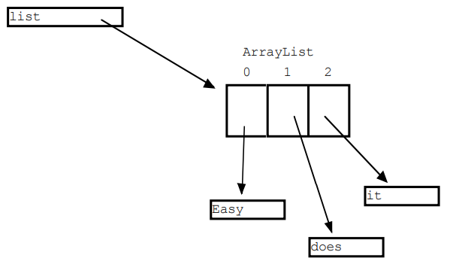

Slide 6
The size() method returns the int current number of elements in the ArrayList.
The get() method takes an int index argument, and returns the pointer at that index number.

Slide 7
ArrayList Constructors
Constructor | Description
1. ArrayList() | Used to build an empty array list
2. ArrayList(Collection<? extends E> c) | Builds an array list that is initialized with the elements of collection c
3. ArrayList(int capacity) | Used to build an array list that has the specified initial capacity

Slide 8
Type wrappers

Slide 9
Need
Java uses primitive types (also called simple types), such as int or double, to hold the basic data types supported by the language.
Primitive types, rather than objects, are used for these quantities for the sake of performance.
Using objects for these values would add an unacceptable overhead to even the simplest of calculations.
Thus, the primitive types are not part of the object hierarchy, and they do not inherit Object.
The standard data structures implemented by Java operate on objects, which means that you can’t use these data structures to store primitive types.
To handle these (and other) situations, Java provides type wrappers, which are classes that encapsulate a primitive type within an object.

Slide 10
Boxing and Unboxing
// Demonstrate a type wrapper.
class Wrap {
public static void main(String[] args) {
Integer iOb = Integer.valueOf(100); //Boxing
int i = iOb.intValue();//Unboxing
System.out.println(i + " " + iOb); // displays 100 100
}
}

Slide 11
Auto-boxing and Auto-unboxing
// Demonstrate autoboxing/unboxing.
class AutoBox {
public static void main(String[] args) {
Integer iOb = 100; // autobox an int
int i = iOb; // auto-unbox
System.out.println(i + " " + iOb); // displays 100 100
}
}
Autoboxing an

Slide 12
Auto-boxing and Auto-unboxing (2)
// Autoboxing/unboxing takes place with method parameters and return values.
class AutoBox2 {
// Take an Integer parameter and return an int value;
static int m(Integer v) {
return v ; // auto-unbox to int
}
public static void main(String[] args) {
// Pass an int to m() and assign the return value to an Integer.
Integer iOb = m(100);
//Here, the argument 100 is autoboxed into an Integer.
//The return value is also autoboxed into an Integer.
System.out.println(iOb);
}
}

